Slide 1
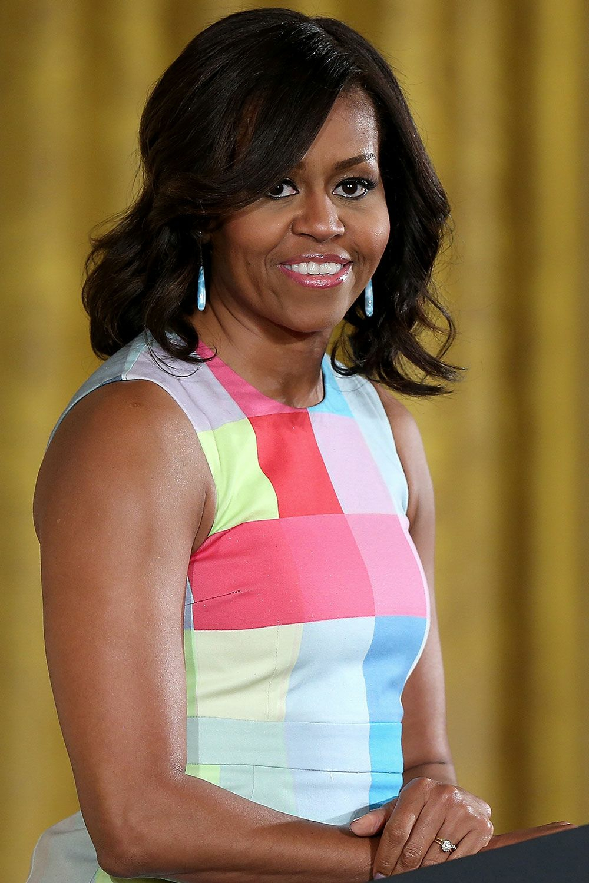



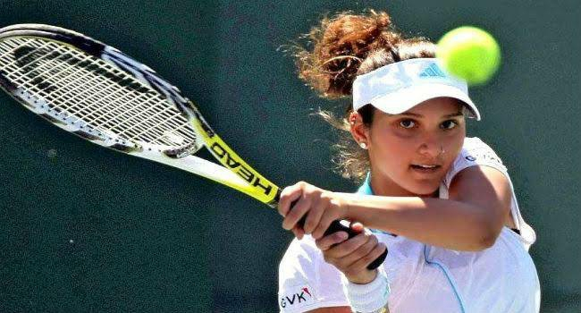
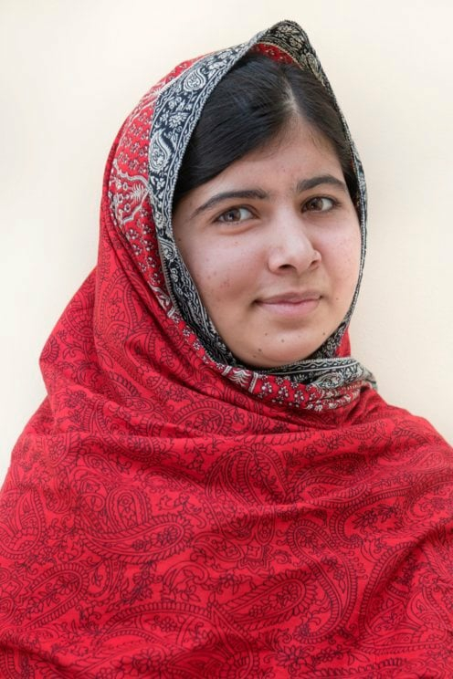
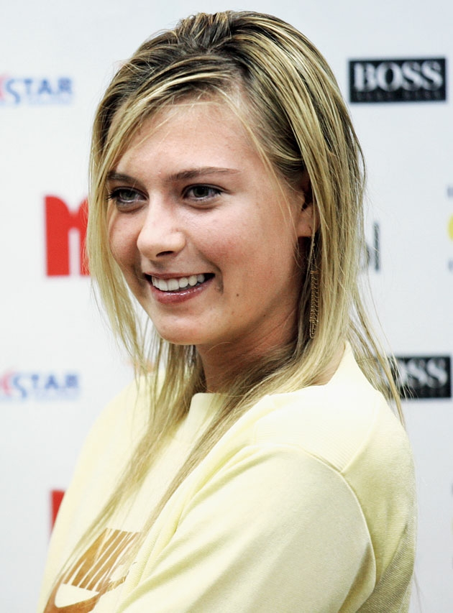
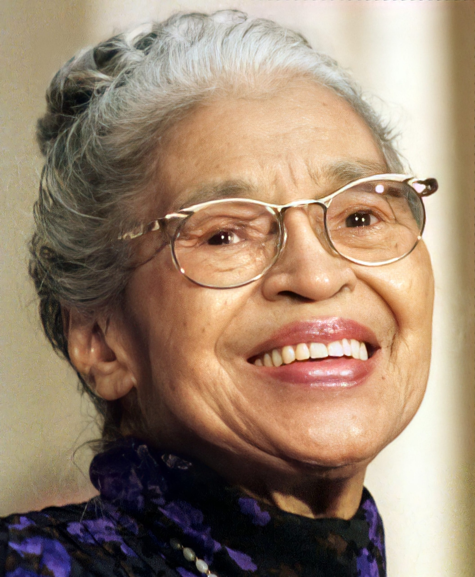
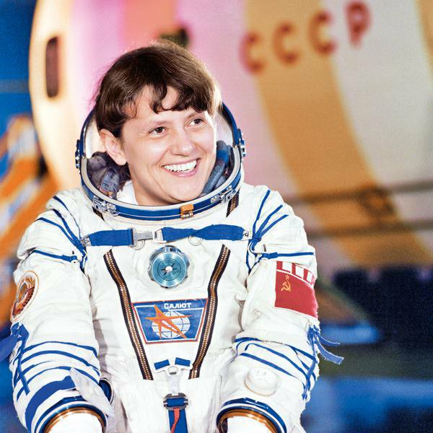
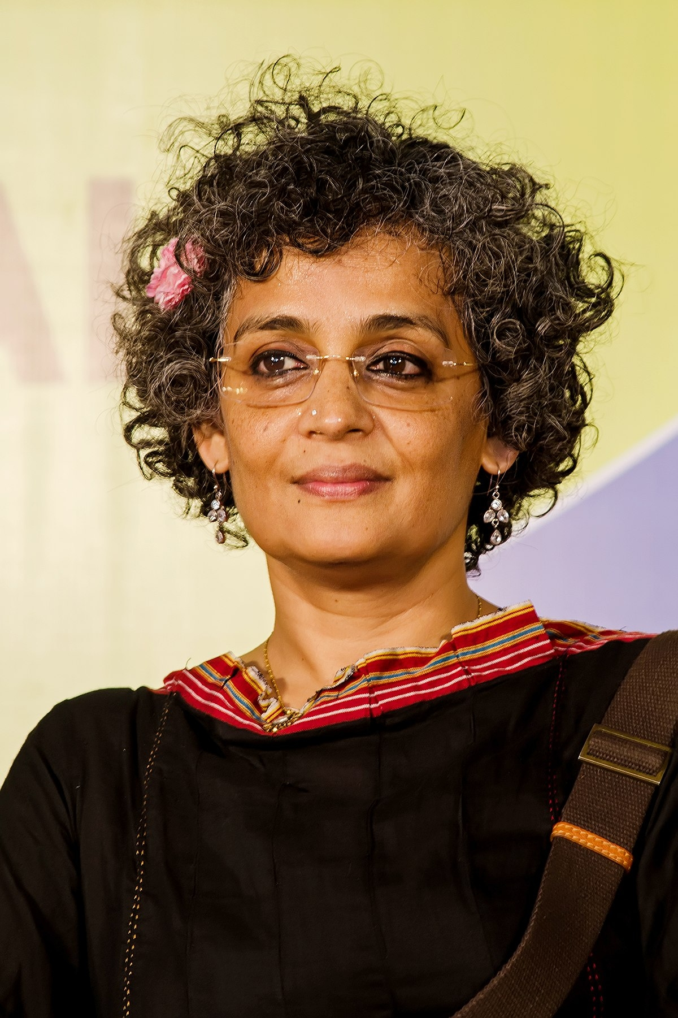
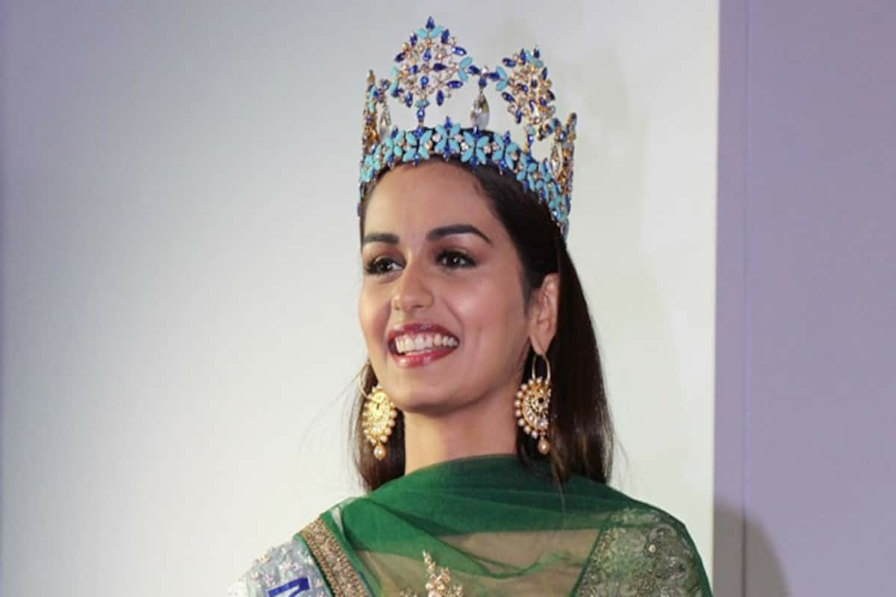
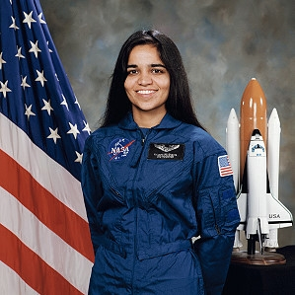
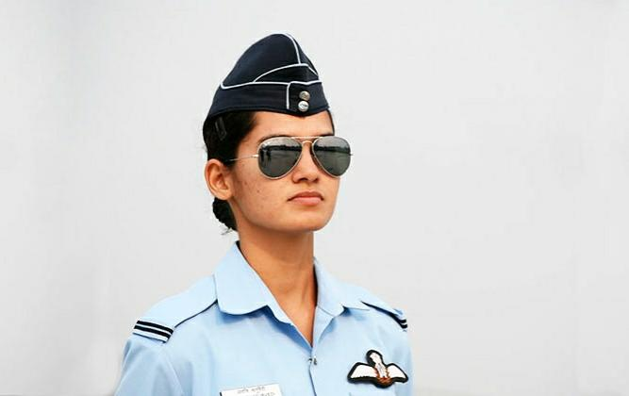
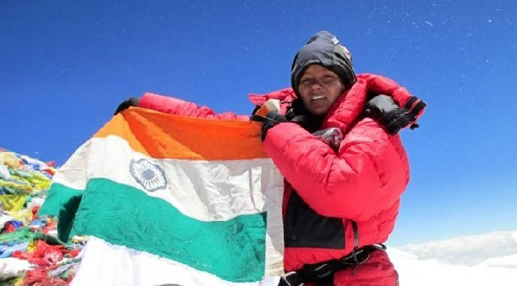
Woman Achievers
Real life Wonder Woman

Slide 2

Acknowledgement
Before starting my presentation,
I would like to express my special Thanks to my English teacher Mrs. Sonika Kundra ma’am for able guidance and support.
This assignment helped me to acquire more knowledge about woman achievers around globe and their stories inspired me.
This assignment helped me to do more research on the topic due to which I was able to expand my knowledge.
Although this assignment has been prepared with utmost care and deep routed interest. I accept respondent and imperfections.

Slide 3
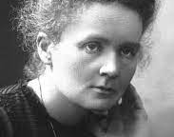
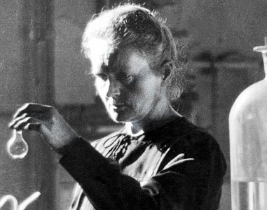
Marie Curie
''Be less curious about people
Be more curious about Ideas''
One of the most recognizable figures in science, “Madame Curie” has captured the public imagination for more than 100 years and inspired generations of women scientists
Marie Sklodowska Curie is a two time Nobel laureate, Marie Curie (1867–1934) was the first person ever to receive two Nobel Prizes: the first in 1903 in physics, shared with Pierre Curie (her husband) and Henri Becquerel for the discovery of the phenomenon of radioactivity, and the second in 1911 in chemistry for the discovery of the radioactive elements polonium and radiumknown for her pioneering studies of radioactivity.

Slide 4
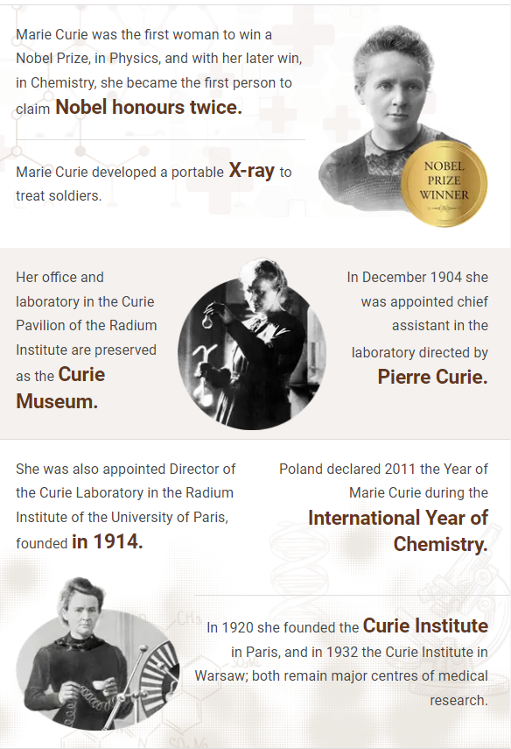
For her thesis she chose to work in a field just opened up by Wilhelm Roentgen’s discovery of X-rays and Becquerel’s observation of the mysterious power of samples of uranium salts to expose photographic film. Curie coined the term RADIOACTIVE.
In 1898, after laboriously isolating various substances by successive chemical reactions and crystallizations of the products, Curie announced the discovery of polonium, and then of radium salts derived from tons of uranium ore. After Pierre’s death in 1906, Marie achieved their objective of producing a pure specimen of radium.
During the war Curie organized a field system of portable X-ray machines to help in treating wounded French soldiers.
Marie Curie has always been an inspiration to all the women out there, she proved that women can do well in science.

Slide 5
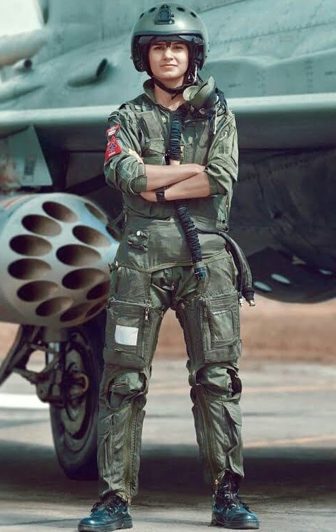
Flying Officer
“Any air force is defined by its fighters. My dream is to become a good fighter pilot, on whom my seniors can rely when it comes to flying live operations. I want to fly the best fighter aircraft and learn more and more each day.”
India's first female fighter pilot Avani Chaturvedi was born on 27 October 1993.
She belongs from a small town in Madhya Pradesh but her dedication and determination towards her goal proved that sky is the limit.

Slide 6


Alliteration
She belongs from a small town in Madhya Pradesh but her dedication and determination towards her goal proved that sky is the limit.
Alliteration happens when words that start with the same sound used repeatedly in a phrase or a sentence. The repeated sound creates the alliteration, not the repeated letter.
For example –
Rachel ran right until she realized, she was running round and round
Here, we can see the sound of letter ‘r’ coming repeatedly in the words Rachel, ran, right, realized, running, round and round.
More examples –
Sugary strawberry salsa softy,
These chocolaty chips are very cheap etc

Slide 7

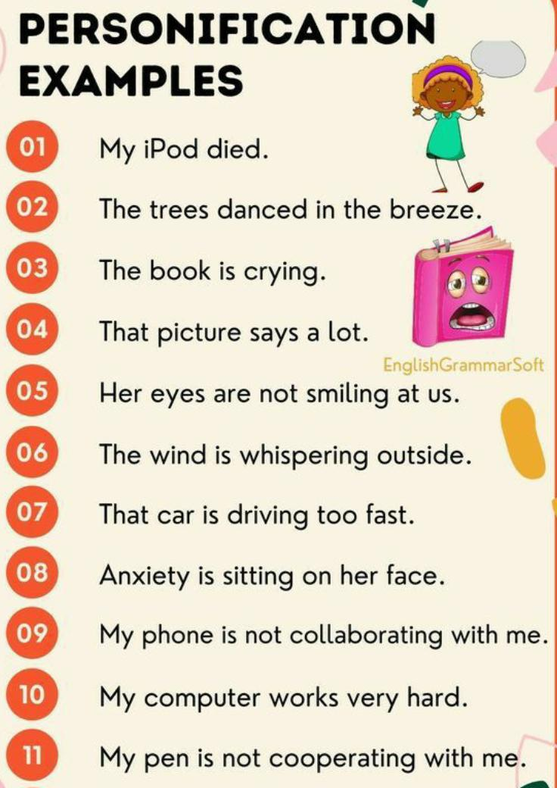
Personification
Personification gives human traits and qualities, such as emotions, desires, sensations, gestures and speech, often by way of a metaphor. Personification is a figure of speech inwhich an idea or thing generally an inanimate object is given human attributes and/or feelings or is spoken of as if it were human. Sometimes an animal can be transformed through personification.
For example –
When all at once I saw a crowd,
A host, of golden daffodils;
Beside the lake, beneath the trees,
Fluttering and dancing in the breeze.
Here, the daffodils are said to “dance”. This is a very clear example of personification because daffodils cannot actually dance they are moved by the wind.
More eg-
Her eyes are not smiling at us, I like onions but they don’t like me! etc

Slide 8


Onomatopoeia
Onomatopoeia is a figure of speech in which words evoke the actual sound of the thing they refer to or describe. Onomatopoeia can use real words or just letters to represent raw sound. A sound of an animal can also be onomatopoeia and that can differ from language to language like sound of a dog in English is woof but in Italian it’s bau.
For example –
The sausages were ‘sizzling’ hot in the pan; The lion ‘roared’ at me; My teeth ‘chattered’ as I stood in the snow;
So, here in the above example words like sizzling, roared and chattered are onomatopoeia.
Real words like ‘z’can be used as an onomatopoeia for sleeping – ‘Zzzzzzzz’. Onomatopoeia also includes sounds of animal like woof for dog etc
More eg-
Pop, crackle, Moo, ding dong, tick tock etc

Slide 9

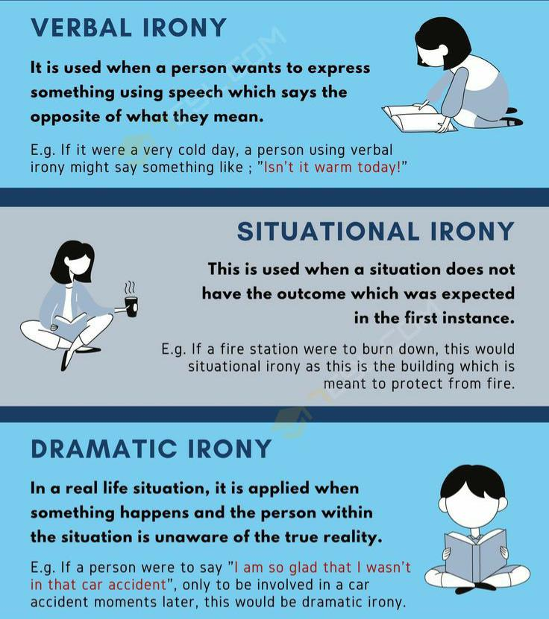
Irony
Irony occurs when actual result is just the opposite of what you thought, there are 4 types of irony. Verbal, dramatic, cosmic and situational in all these, situation is contrast of what expected. Irony inverts our expectations. It can create the unexpected twist at the end of a joke or a story that gets us laughing — or crying.
For example –
In a short story by O. Henry, a wife sells her hair to buy her husband a watch chain, and her husband sells his watch to buy her combs for her hair. Both have made sacrifices in order to buy gifts for one another, but in the end, the gifts are useless. This is a type of situational irony.
A character stepping out into a hurricane and saying, “What nice weather we‘re having!” This is a verbal irony. There can be many more interesting irony.
More examples – a pilot has a fear of heights,
A fire station burns down etc.

Slide 10





At last, Thank you ma’am for giving your precious time to my presentation
🌸
✨
🌸
🌸
This presentation is made by-
Prachika
Class-9G
14590
✨
🌸

